Slide 1
Seaborne 2

Slide 2
SEABORNE LIBRARY

Slide 3

30 Days Python Master Class
Day1 : Python
Time: 6.00 PM IST
Free Registration

Slide 4
Python Master Class
Handbook

Slide 5
NANDHINI.S
Exp: 5 Yrs
Expert in
Python Developer on Machine Learning
Deep learning with computer vision
Matlab – Image Processing
Autonomous Car design using ROS with LIDAR
Language – Python , Java , HTML ,CSS.
Tools – ANACONDA NAVIGATOR, JUPYTER NOTEBOOK,
GOOGLE COLAB.
Graduation : BE – ECE | 2011

Slide 6
Pantech?
Educational Equipment Manufacturer
IoT, AI, Robotics,Autonomous Robot
Microprocessor/Microcontroller
DSP,VLSI, Embedded System
Power Electronics & Drives, Fuel Cell Trainer Kit
Renewable Energy Lab, Electric Vehicle Lab
Technical Training
DIY Project

Slide 7

What is Master Class ?
👍 This is the 30 Days Industrial Learning Activity.
👍 Its Online YouTube Live Class
👍 If you Invest 45 minutes daily, U will become Master in Data Science
👍 You will get FREE E-Certificate
Webinar Participation Certificate
“Learning is the beginning of wealth.
Searching & Learning is where the miracle process all begins.” …………….Jim Rohn

Slide 8
Our Vision
Help 10 Million Students to Learn the Technology in Easy Way

Slide 9

Associate Partner for this Master Class
https://apssdc.in/home/

Slide 10
What U will Learn from 30 Days Data Science & Analytics Master Class

Slide 11

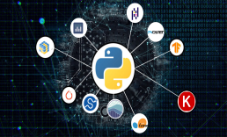



Python Learning Plan
01
02
03
04
05
Library
Python
Analytics
Analytics
Industry Project
Introduction To Python and Python Data Structures
Pandas
Numpy
MatplotLib
Cborn, SKLearn Lib
Collab
Distribution
Visualization
Aggregation
Statistics
Distribution Function
Project Building

Slide 12
Day wise Learning Plan
Day -1 : Introduction to Python
Day -2: Python – Tools|Syntaxes & Data Structures
Day -3: Python – Dictionaries,Date and Time
Day -4: Python – MySql
Day -5: Pandas library – Introduction
Day -6: Pandas library – Data Structures
Day -7: Numpy library – Introduction
Day -8: Numpy library – Array Manipulations, Mathematical Functions
Day -9: Matplotlib , Histogram Using Matplotlib | I/O With Numpy
Day -10: Matplotlib Library - Introduction , Pyplot API | Types Of Plots
Day -11: Seaborn Library
Day -12: SKLearn Library
Day -13: Python – Date and Time , Data Wrangling.
Day -14: Python – Data Cleansing
Day -15: Python – Word Tokenization , Stemming and Lammetization.

Slide 13
Day wise Learning Plan
Day -16: Python – Data Visualization
Day -17: Python – Statistical Analysis
Day -18: Python – Types Of Distribution
Day -19: Python – Correlation ,Chi-Square Test , Linear Regression
Day -20: Keras library – Introduction.
Day -21: Stock Price Prediction With Machine Learning LSTM RNN
Day -22: People’s behaviour in chat message using NLP NLP
Day -23: Gaming In Python
Day -24: Chatbot creation in Python NLP
Day -25: Electricity Price Prediction Using ML Random Forest Regressor
Day -26: Diamond Price Prediction Using Python Linear Regression
Day -27: Book Recommendation System KNN
Day -28: Image Classification Using CNN CNN
Day -29: Titanic Survival Analysis Using ML Logistic Regression
Day -30: Blockchain in Python

Slide 14
List of Projects for Demo in YouTube Live
Stock Price Prediction With Machine Learning
People’s behaviour in chat message using NLP
Gaming In Python
Chatbot creation in Python
Electricity Price Prediction Using ML
Diamond Price Prediction Using Python
Book Recommendation System
Image Classification Using CNN
Titanic Survival Analysis Using ML
Blockchain in Python
All Projects in Jupyter Notebook

Slide 15
What you will get from this Free 30 Days Master Class?
You can attend YouTube Live Class
Free E-Certificate ( WEBINAR PARTICIPATION CERTIFICATE)

Slide 16
How to mark your Attendance in YouTube Live Class?
Ans : During the Live Class, organizer will post Google Form link in Live Chat. The Participants should submit the from on daily basis. Minimum 25 Days Attendance is Required to get Free Master Class Participation Certificate.
Note : The Link will be available during the Live. From the LIVE Class date, the live video will get removed from the YouTube in 3 days.

Slide 17


Sample Webinar Participation Certificate?

Slide 18
https://www.pantechelearning.com/data-science-master-class/
On Demand
You can get chance to apply 1 Month Internship on Data Science & Analytics Master Class

Slide 19
What is Internship????
Learn
Practice
Verify
Get Certified
Grow

Slide 20
Free Master Class DSA | 1 Month Internship on DSA
Master Class Participation Certificate | Internship Completion Certificate
Minimum 25 Class should attend YouTube Live | Recorded Class Link will be provided. – LMS Portal Access
YouTube Live Mandatory | Your Choice. You can attend Live or else You can watch Recorded Class in LMS Portal
All Projects Demo class in YouTube Live | Step by Step Video Explanation Content in LMS Portal
Access : 3 Days | VIP WhatsApp Group Support
 | You Can Download All PPTs
 | 4 Nos of Hackathon Class in Zoom Live. The Recording also will be provided
 | You Can Download All Project Files
 | Mentor will guide you to finish 10 Projects
 | Access : 60 Days

Slide 21
Pantech will make you to Create 10 Projects in Data Science & Analytics in 30 Days
Objective of this 30 Days Master Class

Slide 22
1 Month Internship in Data Science
INTERNSHIP E-Certificate(30Days Internship on Data Science Engineering)
Highly organized Video content
Download All Files
Download PPTs
Assignments
Flexible Time.
Access Period: 60Days from the date of payment

Slide 23
What You Will Get???
Complete Project Files
30 Days Learning Activity
Data Science Core Concepts
10 + Projects
Project PPT
Spatial Data Science For Covid-19 Disease Prediction
Parkinson’s Disease Prediction-XGBoost Classifier
House Price Prediction-Random Forest Regression
Customer Segmentation Using ML-K-Means Clustering
Home Loan Prediction-Decision Tree Classifier
Spam Classification-NLP
Hand Written Digit Recognition Using Python-CNN
Churn Prediction-Deep Learning
Crop Yield Prediction
Ground water level prediction
Video Class Access for 2 Months
Get chance to Enroll 1-Month Internship on demand

Slide 24
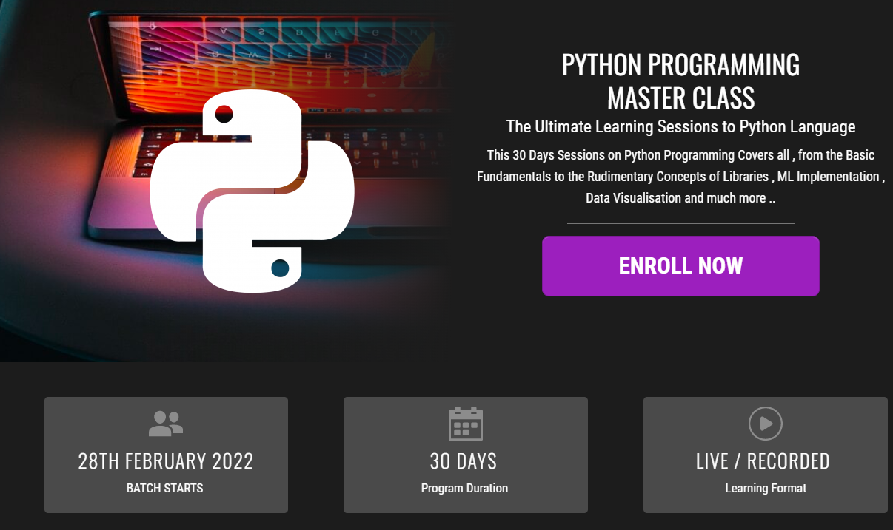
How to join in 1 month Internship
https://www.pantechelearning.com/pymc-internship/
Coupon Code: PYMC

Slide 25
Seaborn - histogram
Histogram denote the data representation by forming bins along the range of data.
Then drawing bars to show the number of observations in each bin.
Seaborn comes with a lot of datasets.

Slide 26
EXAMPLE:
import pandas as pd
import seaborn as sb
from matplotlib import pyplot as plt
df = sb.load_dataset('iris')
sb.distplot(df['petal_length'],kde = False)
plt.show()
Here , kde flag is set to False.
The representation of kernel estimation plot will be removed and only histogram is plotted.

Slide 27
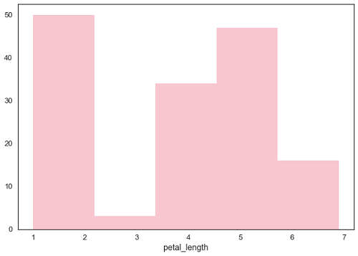
OUTPUT:

Slide 28
Seaborn – kernel density estimates:
Kernel Density Estimation(KDE) is a way to estimate the probability density function of a continuous random variable.
It is used for non-parametric analysis.
If we set the hist flag to false , it will kernel density estimation plot.

Slide 29
EXAMPLE:
import pandas as pd
import seaborn as sb
from matplotlib import pyplot as plt
df = sb.load_dataset('iris')
sb.distplot(df['petal_length'],hist=False)
plt.show()

Slide 30
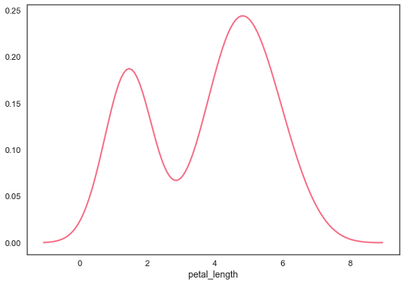
Output:

Slide 31
FITTING PARAMETRIC DISTRIBUTION:
Distplot() is used to visualize the parametric distribution of the dataset.
Example:
import pandas as pd
import seaborn as sb
from matplotlib import pyplot as plt
df = sb.load_dataset('iris')
sb.distplot(df['petal_length'])
plt.show()

Slide 32
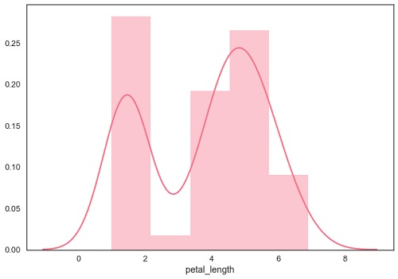
Output:

Slide 33
Removing Axes Spines:
In the white and ticks spines , we can remove the top and right axis spines using the despine() function.
Example:
import numpy as np
from matplotlib import pyplot as plt
def sinplot(flip=1):
x = np.linspace(0, 14, 100)
for i in range(1, 5):
plt.plot(x, np.sin(x + i * .5) * (7 - i) * flip)
import seaborn as sb
sb.set_style("white")
sinplot()
sb.despine()
plt.show()

Slide 34
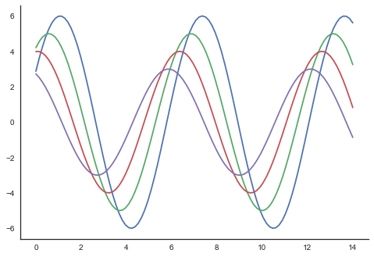
Output:

Slide 35
Overriding The Elements:
If we want to customize the seaborn styles , we can pass a dictionary of parameters to the set_style() function.
Parameters available are viewed using axes_style() function.
Example:
import seaborn as sb
print (sb.axes_style)

Slide 36
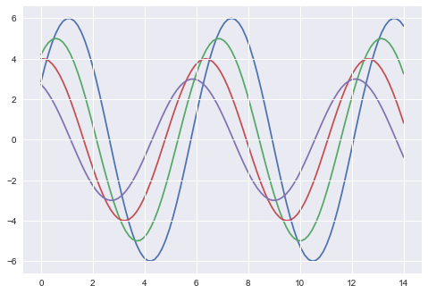
Output:

Slide 37
Scaling Plot Elements:
We also have control on plot elements and can control the scale of the plot using set_context() function.
Four preset templates are available for contexts.
Based on relative size , the contexts are named as follows:
Paper
Notebook.
Talk
Poster.
By default , context is set to notebook.

Slide 38
Example:
import numpy as np
from matplotlib import pyplot as plt
def sinplot(flip = 1):
x = np.linspace(0, 14, 100)
for i in range(1, 5):
plt.plot(x, np.sin(x + i * .5) * (7 - i) * flip)
import seaborn as sb
sb.set_style("darkgrid")
sinplot()
sb.despine()
plt.show()

Slide 39
Output:
The output size of the actual plot is bigger in size when compared to the above plots.
Note: Due to the scaling of images on our webpage , we might miss the actual difference in our example plots.

Slide 40
Seaborn - histogram
Histogram denote the data representation by forming bins along the range of data.
Then drawing bars to show the number of observations in each bin.
Seaborn comes with a lot of datasets.

Slide 41
PLOTTING BIVARIATE DISTRIBUTION:
Bivariate distribution is used to find the distribution between two variables.
It mainly deals with the relationship between two variables and how one variable is behaving with respect to other.
The best way to analyze bivariate distribution in seaborn is by using jointplot() function.
Jointplot creates a multi-panel figure that projects the bivariate relationship between two variables.
It also defines the univariate distribution of each variable on separate axes.

Slide 42
SCATTER PLOT:
It is the most convenient way to visualize the distribution.
Each observation is represented in two dimensional plot via x and y axes.
Example:
import pandas as pd
import seaborn as sb
from matplotlib import pyplot as plt
df = sb.load_dataset('iris')
sb.jointplot(x = 'petal_length',y = 'petal_width',data = df)
plt.show()

Slide 43
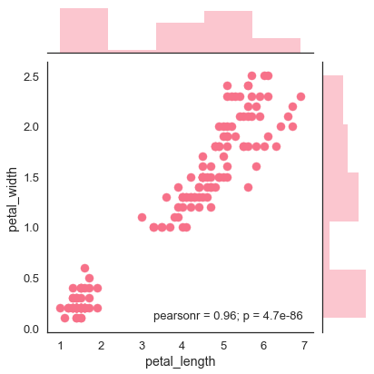
Output:

Slide 44
Output:
It shows the relationship between petal_length and petal_width in the iris data.
A trend in the plot shows that there exists a positive correlation between variables.

Slide 45
Hexbin plot:
Hexagonal binning is used in bivariate data analysis.
It is used when the data is sparse in density , i.e when the data is very scattered and difficult to analyze through scatter plots.
An addition parameter called ‘kind’ and value ‘hex’ plots the hexbin plot.

Slide 46
EXAMPLE:
import pandas as pd
import seaborn as sb
from matplotlib import pyplot as plt
df = sb.load_dataset('iris')
sb.jointplot(x = 'petal_length',y = 'petal_width',data = df,kind = 'hex')
plt.show()

Slide 47
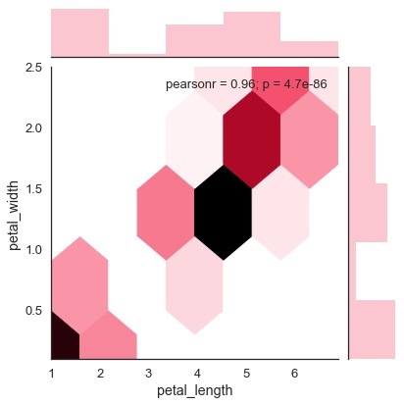
Output:

Slide 48
Kernel density estimation:
It is a non-parametric way to estimate the distribution of the variable.
In seaborn , we can plot the kde using jointplot().

Slide 49
Example:
import pandas as pd
import seaborn as sb
from matplotlib import pyplot as plt
df = sb.load_dataset('iris')
sb.jointplot(x = 'petal_length',y = 'petal_width',data = df,kind = 'hex')
plt.show()

Slide 50
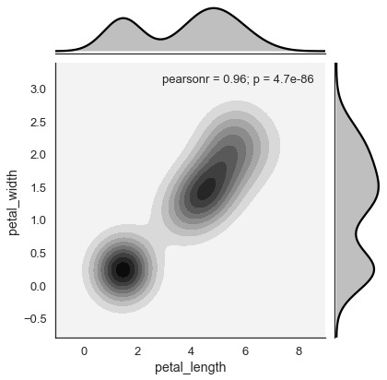
Output:

Slide 51
Seaborn – visualizing pairwise relationship
Datasets under study contains many variables.
The relation between each and every variable should be analyzed.
Plotting bivariate distribution for (n,2) distribution will be a very complex process.
It is a time taking process.
To plot multiple pairwise distribution in a dataset , we can use the pairplot() function.
It shows the relationship between (n,2) combinations in a dataframe.

Slide 52
Seaborn – visualizing pairwise relationship
It shows the plot as a matrix of plots and diagonal plots are the univariate plots.
Axes:
Usage:
seaborn.pairplot(data,…)
Parameters:
Data – dataframe.
Hue – Variable in data to map plot aspects to different colours.
Palette – Set of colors for mapping the hue variable.
Kind – Kind of plot for the non-identity relationships(scatter,reg)
Diag_plot – kind of plot for diagonal subplots{‘hist’,’kde’}

Slide 53
Seaborn – visualizing pairwise relationship
Except data , all other parameters are optional.
There are few other parameters which pairplot() can accept.

Slide 54
example:
import pandas as pd
import seaborn as sb
from matplotlib import pyplot as plt
df = sb.load_dataset('iris')
sb.set_style("ticks")
sb.pairplot(df,hue = 'species',diag_kind = "kde",kind = "scatter",palette = "husl")
plt.show()

Slide 55
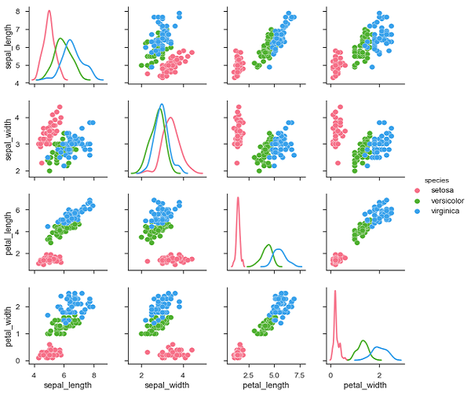
Output:

Slide 56
SEABORN – PLOTTING CATEGORICAL DATA
We have learnt about scatter plots, hexbin plots and kde plots.
These plots are used to analyze the continuous variables under study.
These plots are not suitable when the variable under study is categorical.
When one or two variables under study are categorical, we use plots like striplot(),swarmplot()etc.

Slide 57
CATEGORICAL SCATTER PLOTS:
There are various categorical scatter plots.
Stripplot():
It is used when one of the variable under study is categorical.
It denotes the data in sorted order in any one of the axes.
Example:
import pandas as pd
import seaborn as sb
from matplotlib import pyplot as plt
df = sb.load_dataset('iris')
sb.stripplot(x = "species", y = "petal_length", data = df)
plt.show()

Slide 58
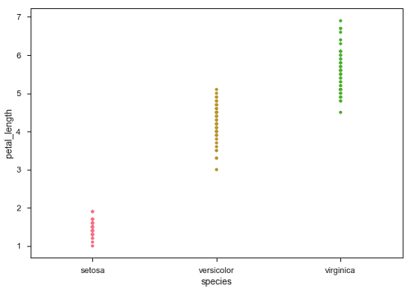
Output:

Slide 59
PLOT DESCRIPTION
In the above plot , we can clearly see the difference of petal_length in each species.
The main problem with the scatter plot is that the points on the scatter plot are overlapped.
‘Jitter’ parameter is used to handle this kind of scenario.
Jitter adds some random noise to the data.
The parameter will adjust the positions along the categorical axes.

Slide 60
Example:
import pandas as pd
import seaborn as sb
from matplotlib import pyplot as plt
df = sb.load_dataset('iris')
sb.stripplot(x = "species", y = "petal_length", data = df, jitter = True)
plt.show()

Slide 61
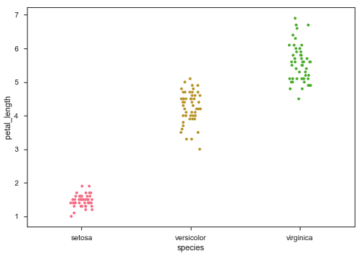
Output:

Slide 62
Swarmplot():
Another option which can be used as an alternate to ‘jitter’ is function swarmplot().
This function positions each point of scatter plot on the horizontal axis and it avoids overlapping points.

Slide 63
EXAMPLE:
import pandas as pd
import seaborn as sb
from matplotlib import pyplot as plt
df = sb.load_dataset('iris')
sb.swarmplot(x = "species", y = "petal_length", data = df)
plt.show()

Slide 64
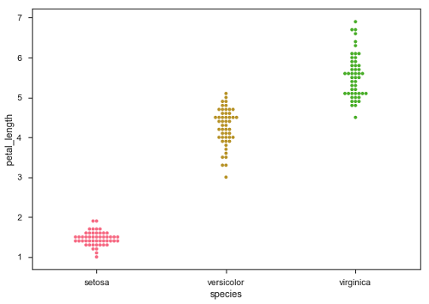
Output:

Slide 65
Seaborn – distribution of observations
Categorical scatter plots provide about the distribution of values within each category.
Box Plots:
It is a good way to visualize the distribution of data through their quartiles.
Box plots usually have vertical lines extending from the boxes and they are termed as whiskers.
Whiskers indicate variability under upper and lower quartiles.
Box plots are also termed as box and whisker plots and box and whisker diagram.
Any outliers in the data are plotted as individual points.

Slide 66
EXAMPLE:
import pandas as pd
import seaborn as sb
from matplotlib import pyplot as plt
df = sb.load_dataset('iris')
sb.boxplot(x = "species", y = "petal_length", data = df)
plt.show()

Slide 67
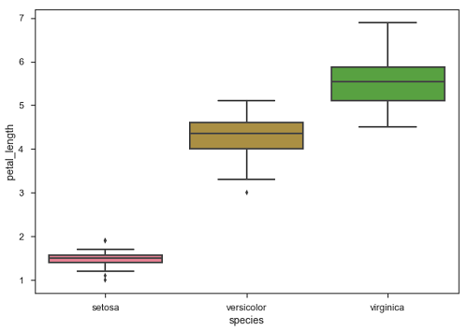
Output:

Slide 68
OUTPUT:
The dots on the plot indicates the outlier.

Slide 69
Violin plots:
They are a combination of box plots with kernel density estimates.
These plots are easier to analyze and understand the distribution of data.
Tips dataset is used to learn more into the violin plots.
Dataset contains information related to the tips given by the customers in the restaurant.

Slide 70
example:
import pandas as pd
import seaborn as sb
from matplotlib import pyplot as plt
df = sb.load_dataset('tips')
sb.violinplot(x = "day", y = "total_bill", data=df)
plt.show()

Slide 71
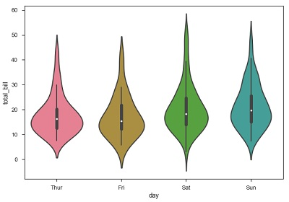
Output:

Slide 72
Description:
The quartile and whisker values from the boxplot are shown inside the violin.
The violin plot uses KDE(Kernel Density Estimates)
The wider portion of violin provides wider density and narrow portion indicates lower density.
The inter-quartile range in boxplot and high density region in kde fall in the same region of each category of violin plot.

Slide 73
Description:
The above plot shows the distribution of total_bill on four days of a week.
If we want to know how distribution behaves with respect to sex, we will see in the following example.
import pandas as pd
import seaborn as sb
from matplotlib import pyplot as plt
df = sb.load_dataset('tips')
sb.violinplot(x = "day", y = "total_bill",hue = 'sex', data = df)
plt.show()

Slide 74
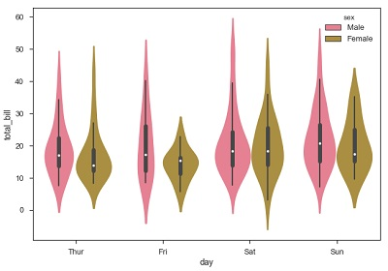
Output:

Slide 75
Output description:
We can clearly see the spending behavior between male and female.
We can easily say that men make more bill when compared to women by looking at the plot.
Hue variable has only two classes.
We can beautify the plot by splitting each violin into two instead of two violins on a day.
Either parts of the violin refer to each class in the hue variable.

Slide 76
Example:
import pandas as pd
import seaborn as sb
from matplotlib import pyplot as plt
df = sb.load_dataset('tips')
sb.violinplot(x = "day", y="total_bill",hue = 'sex', data = df)
plt.show()

Slide 77
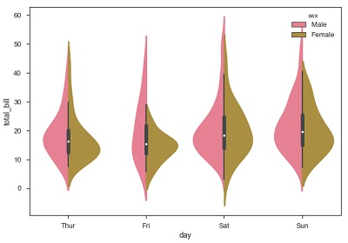
Output:

Slide 78
SEABORN – STATISTICAL ESTIMATION:
We deal with the estimations of whole distributions of data.
When it comes to central tendency estimation , we need a specific way to summarize the distribution.
Mean and median are the widely used techniques to estimate the central tendency of the distribution.
The following plots are used to estimate the central tendency of the distribution.

Slide 79
Bar plot:
The barplot() shows the relation between categorical variable and the continuous variable.
The data is represented in rectangular bars.
The length of the bar represents the proportion of data in that category.
Bar plot denotes the estimate of central tendency.

Slide 80
Example:
import pandas as pd
import seaborn as sb
from matplotlib import pyplot as plt
df = sb.load_dataset('titanic')
sb.barplot(x = "sex", y = "survived", hue = "class", data = df)
plt.show()

Slide 81
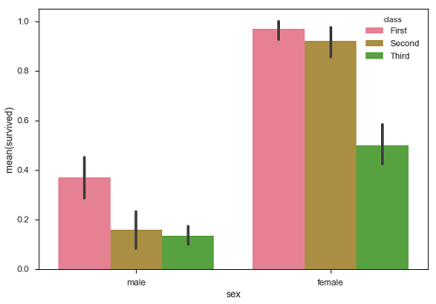
Output:

Slide 82
Output - description
In the above example , we can see that the average number of survivals of male and female in each class.
From the plot , we can understand more number of females survived than males.
A special case in barplot is to show the number of observations in each category.
It does not compute a statistic for a second variable.
For this , we use countplot().

Slide 83
Example:
import pandas as pd
import seaborn as sb
from matplotlib import pyplot as plt
df = sb.load_dataset('titanic')
sb.countplot(x = ‘class ‘, data = df, palette = "Blues");
plt.show()

Slide 84
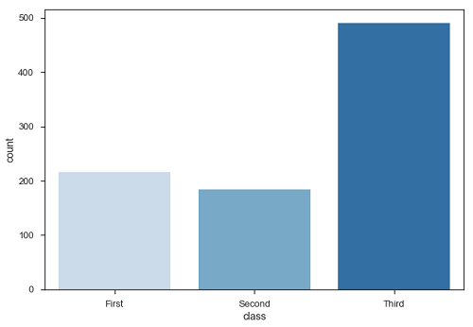
Output:

Slide 85
OUTPUT:
Number of passengers in the third class are higher than the first and second class.
Point plots: It serve same as the bar plot but in a different style.
Rather than the full bar , the value of the estimate is denoted by a point on a certain height on the different axes.

Slide 86
EXAMPLE:
import pandas as pd
import seaborn as sb
from matplotlib import pyplot as plt
df = sb.load_dataset('titanic')
sb.pointplot(x = "sex", y = "survived", hue = "class", data = df)
plt.show()

Slide 87
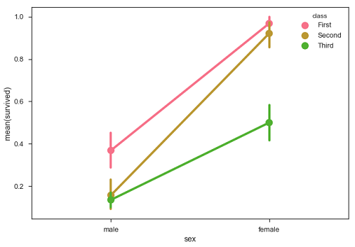
OUTPUT:

Slide 88
SEABORN – PLOTTING WIDE BORN DATA
It is preferable to use ‘long-from’ or ‘tidy’ datasets.

